Slide 1
Graphical Elegance Is Often Found In Simplicity Of Design And Complexity Of Data.
- Edward R. Tufte

Slide 2

Who let the dogs out? MODELING DOG BEHAVIOUR FROM VISUAL DATA .
Based On: K. Ehsani, H. Bagherinezhad, J. Redmon, R. Mottaghi and A. Farhadi, “Who let the dogs out? modeling dog behavior from visual data,” IEEE/CVF Conference Computer Vision and Pattern Recognition, Salt Lake City, UT, 2018, pp.4051-4060.
Presenter: Ashish Kumar
Student ID:108998404
Email: singh.ashish.kr96@gmail.com

Slide 3
CONTENTS
Proposed work by authors
Introduction
Dataset
Acting like a dog
Planning like a dog
Learning from a dog
Experiment
Results
Conclusion and Future Scope

Slide 4
Proposed work by authors
Authors propose the task of directly modelling a visually intelligent agent rather than common approach of computer vision which typically focuses on solving various subtasks related to visual intelligence.
Authors model takes visual information as input and directly predicts action of agent.
Authors introduce here DECADE- a dataset of ego centric videos from dogs perspective as well as her corresponding movements.
Authors claim strong results on the task of walkable surface estimation and scene classification by using their dog modelling task as representation learning.

Slide 5
introduction
Computer vision research typically focuses on a few well defined task including image classification, object recognition, object detection, image segmentation etc. these task have originally emerged and serve as proxies for actual problem of visual intelligence.
Authors were inspired to perform this research on the basis of recent work on:
Experiment learning of intuitive physics
Learning visual representations via physical interactions
Visual semantic planning using deep successor representations
Under this definition they propose to learn to act like a visually intelligent agent in visual world.
Authors choose to model a dog as visually intelligent agent because dogs have much simpler action space rather than human making the task more tractable. Thus they propose to modelling a black box where they only know the input and outputs of the system.

Slide 6
Authors compile dataset DECADE (Dataset of ego centric actions in dog environment) for recording movements IMU(inertial measurement units)were mounted on the joints and body of the dog. With this they record absolute positions and can calculate the relative angle of dogs main limbs and body.
Using DECADE three main problems were discovered:
Learning to act like a dog – here they study the problem of predicting dogs future moves, in term of all joint movements, by observing what the dog has observed up to current time.
Learning to plan like a dog – here, the problem of estimating a sequence of movements that take the state of dogs world from what is observed at a given time to a desired observed state was addressed.
In using dogs as supervision – they explore the potentials of using the dog movements for representation learning.
Their evaluations shows results such as:-
Their model can predict how dog moves in various scenario. (Act Like A Dog)
How dogs plan to move from one state to another. (Plan like A Dog)
In addition they saw accuracy improvements using their dog model. As pre-training for walkable surface estimation and scene recognition.

Slide 7
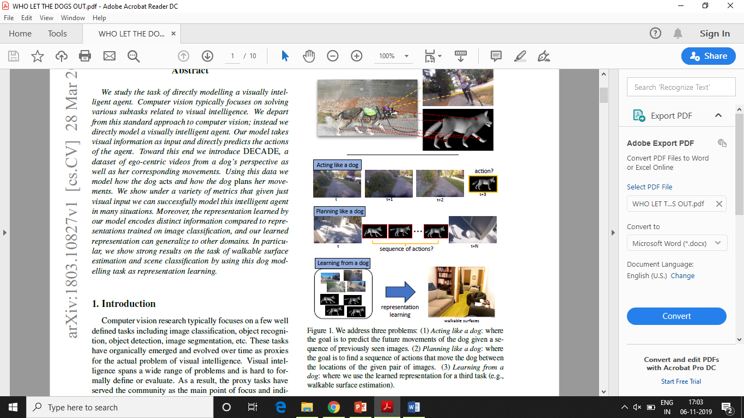
Figure 1. Authors address three problems:
(1) Acting like a dog: where the goal is to predict the future movements of the dog given a sequence of previously seen images.
(2) Planning like a dog: where the goal is to find a sequence of actions that move the dog between the locations of the given pair of images.
(3) Learning from a dog: where they use the learned representation for a third task (e.g. walkable surface estimation)

Slide 8
dataset
Dataset includes 380 video clips from camera mounted on dogs head.
It includes information about body position and movements.
Overall, they have 24500 frames, they used 21000 of them for training , 1500 for validation and 2000 for testing.
A Gopro camera was used by authors to capture ego- centric videos then they sub sample frames at the rate of 5 Fps.
The camera applied video stabilization to the captured stream and they used inertial measurement units (IMU) to measure the body position and movement.
4 IMU measured dogs limbs
1 IMU measured dogs tail
1 IMU measured dogs body position
This helped them to capture movements in terms of angular displacements.

Slide 9
For each frame they collected absolute angular displacement of the six IMUs. Each angular displacement is represented as a 4 dimensional quaternion vector.
The difference of the angular displacements between two consecutive frame(i.e. 0.2 sec in time) represent the action of the dog in that timestep.
An Arduino on dogs back connects to the IMUs and removed the positional information. It collects audio via microphone mounted on dogs back and they synchronize the Gopro with IMU measurement using audio information.
Video stream synchronize the IMU readings to attain microsecond precision.
DATA COLLECTION
The data was collected in various outdoor and indoor scenes.
Data is recorded in more than 50 different locations dogs behaviour was recorded while doing different activities.
All raw data was used for this experiment and no annotations are provided in video frame.

Slide 10
Acting like a dog
The dog future actions were modelled using a sequence of previously seen images.
The input is a sequence of image frames (I₁, I₂,…,I_{t}), and the output is the future actions (movements) of each joint j at each timestep t < t’ <= N: (a^{j}_{t+1}; a^{j}_{t+2},…., a^{j}_{t+N}). Time steps are spaced evenly by 0.2s in time.
The action a^{j}_{t} is the movement of the joint j, that along with the movements of other joints, takes us from image frame I_{t} to I_{t+1}. For instance, a²₃ Represents the movement of the second joint that takes place between image frames I₃ and I₄. Each action is the change in the orientation of the joints in the 3D space.
Here, the problem is formulated as classification i.e. authors quantize joint angular movements and label each joint movement as a ground-truth action class.
For obtaining action classes authors cluster changes in IMU readings (joint angular movements) by K means and used quaternion angular distances to represent angular distances between quaternions. Each cluster centroid represent possible movement of that joint.

Slide 11
Movement prediction model is based on an encoder-decoder architecture where goal is to find mapping between input images and future actions. Ex: dog sees owner with chips or throwing ball.
The encoder part of the model consists of a CNN and an LSTM. At each timestep, the CNN receives a pair of consecutive images as input and provides an embedding, which is used as the input to the LSTM.
Decoder gets initial hidden state and cell from encoder. At each time step we find prediction of other time step, embedded by a liner transformer.
System is trained with fixed output length so no stop token is required and it always stop at fix number of steps.
At each timestep 6 classes of actions are outputted as there are 6 joints in total.
Each image is given to ResNet-18 tower individually and features of two images are concatenated. combined features are embedded into smaller space by a liner transformation. The embedded features are fed into the encoder LSTM.
Authors used a ResNet pre-trained on ImageNet and then fine tune it under a Siamese setting to estimate the joint movements between two consecutive frames.
Authors used the average of weighted class entropy losses one for each joint to train the encoder decoder.

Slide 12
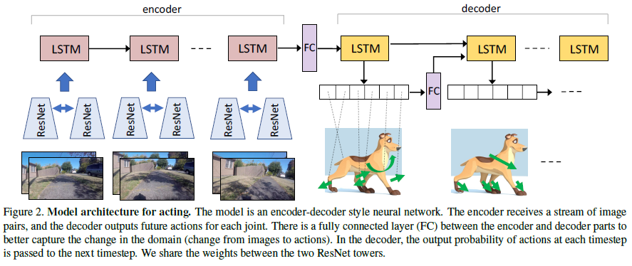
MODEL ARCHITECTURE FOR ACTING

Slide 13
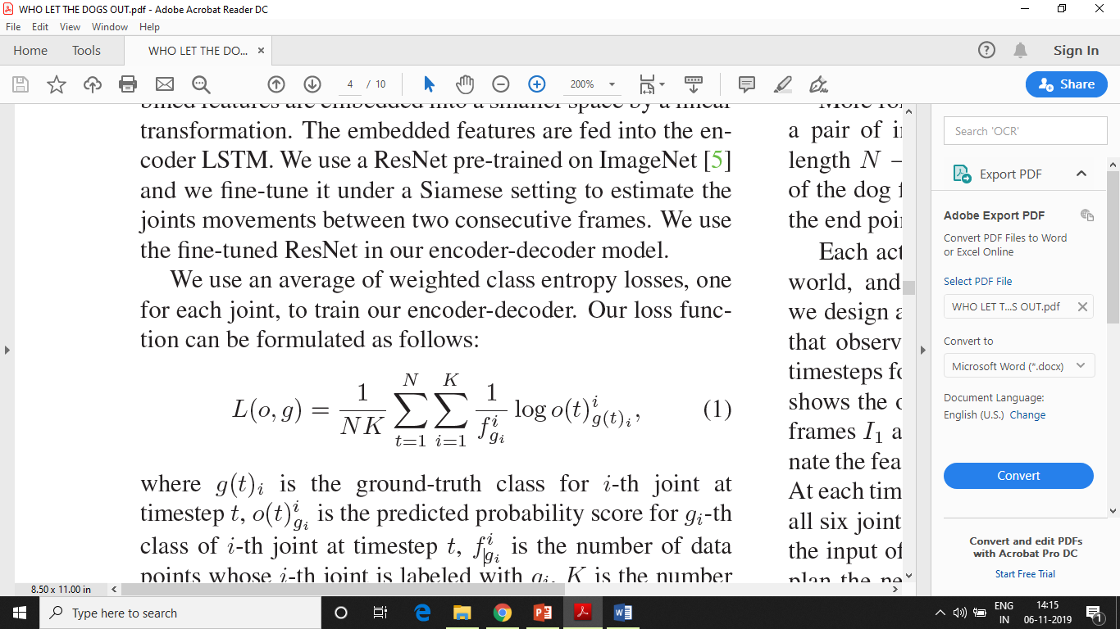
Loss function can be formulated as:
where g(t)_{i} is the ground-truth class for i-th joint at timestep t
o(t)^{i}_{gi} is the predicted probability score for g_{i}-th class of i-th joint at timestep t
f^{i}_{gi} is the number of data points whose i-th joint is labeled with g_{i}
K is the number of joints
N is the number of time steps
The 1/f^{i}_{gi} factor helps the ground-truth labels that are underrepresented in the training data

Slide 14
Planning like a dog
Another goal is to model how dogs plan actions to accomplish a task.
For achieving this, authors design a task as follows:
Given a pair of non-consecutive image frames, plan a sequence of joint movements that the dog would take to get from the first frame (starting state) to the second frame (ending state). Also a traditional motion estimator would not work here.
Motion estimators infer a translation and rotation for the camera that can take us from an image to another. In contrast, here they expect the model to plan for the actuator, with its set of feasible actions, to traverse from one state to another.
Authors designed a recurrent neural network, containing an LSTM that observes that actions taken by model in previous time steps for the next timestamp action prediction.

Slide 15
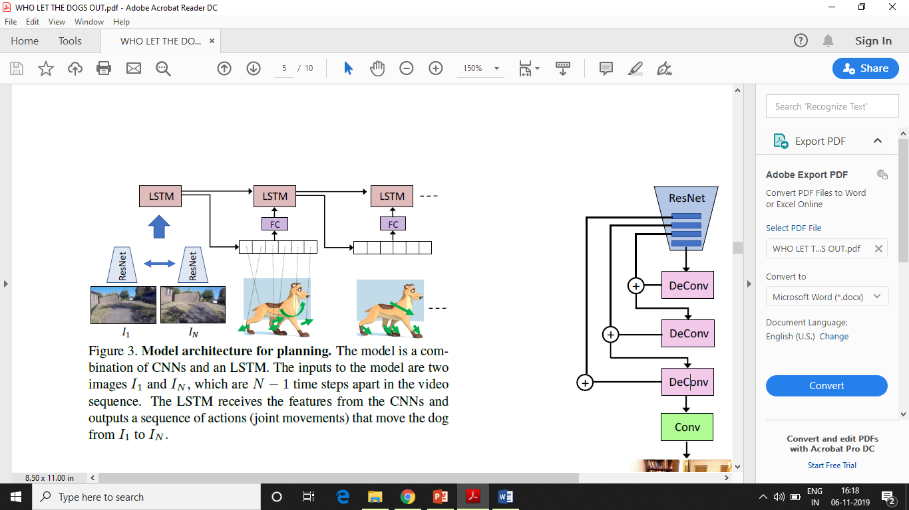
MODEL ARCHIITECTURE FOR PLANNING
Image frame I₁ and I_{N} are given to individual ResNet-18 towers.
Features are concatenated from the last layer & feed to LSTM.
At each time step LSTM cell outputs planned action for all 6 joints.
Planned action are passed as input to next timestep so next movements are planned according to previous actions.

Slide 16
Learning from a dog
While learning to predict the movements of the dog joint’s from the images that the dog observes authors obtain an image representation that encodes different types of information.
For learning representation, they trained a ResNet-18 model to estimate the current dog movements (the change in the IMUs from time t-1 to t) by looking at the images that the dog observes in time t-1 and t.
Then they test that representation and compared it with a ResNet-18 model trained on ImageNet, in a different task using separate data.
For their experiments they choose the task of walkable surface estimation “A task- oriented approach for cost sensitive recognition’’ and scene categorization using SUN397 dataset “Largescale screen recognition from abbey to zoo”.

Slide 17
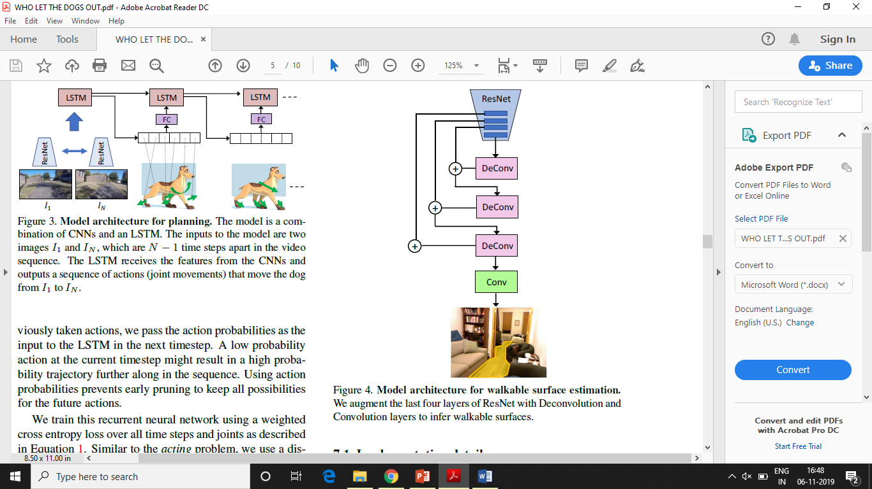
To showcase the effects of authors representation, they replaced the ResNet-18 part of the model shown in blue with a ResNet trained on ImageNet and compare it with a ResNet trained on DECADE.
Figure depicts the model for estimating the walkable surfaces from an image.
Authors augment the last four layers of ResNet with Deconvolution and Convolution layers to infer walkable surfaces.

Slide 18
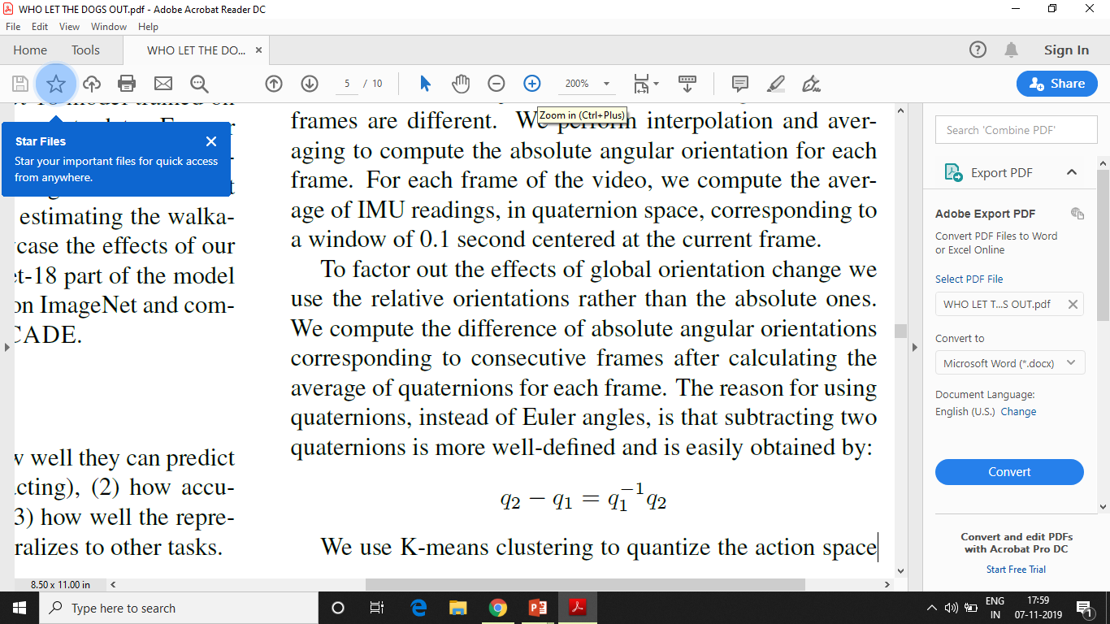
Experiment
Inertial measurement units were used to obtain the angular displacements of the dog joints.
To synchronize all the IMUs together, authors connected all the IMUs to the same embedded system (Raspberry pi 3.0).
Go pro was used on dogs head to capture videos and the images were sub-sampled at the rate of 5 frames per second.
To synchronize the Gropro and Raspberry pi audio was used which was recorded on both the instruments.
The rate of joint movement readings and video frame are different authors perform interpolation and averaging to compute absolute angular orientation for each frame.
Authors compute the difference of absolute angular orientations corresponding to consecutive frames after calculating the average of quaternions for each frame.
Reason for using quaternions instead of Euler angles, is that subtracting two quaternions is more well defined and is easily obtained by:

Slide 19
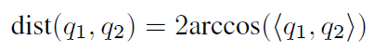
K- means clustering was used to quantize the action space. The distance function for K- means clustering is defined by:
Authors formulated problem as classification rather than regression because their experimental evaluations showed that CNN obtain better results for classification.
Every joint was treated separately during training, 3910 different joint configurations appear in their training data. Also their experiment showed pre-joint clustering is better all-joint clustering.
For visualizing dog movements a 3D model was used from “3D menagerie: Modeling the 3D shape and pose of animals”.
Learning To Act
Input to the acting network are pair of frames of size 224 X 224 and output is sequence of movements predicted for future actions of the dog.
The outputs of ResNets which are of size 512 are concatenated into a vector size of 1024.
The encoder LSTM has a hidden size of 512, and the initial hidden and cell states are set to zeros.

Slide 20
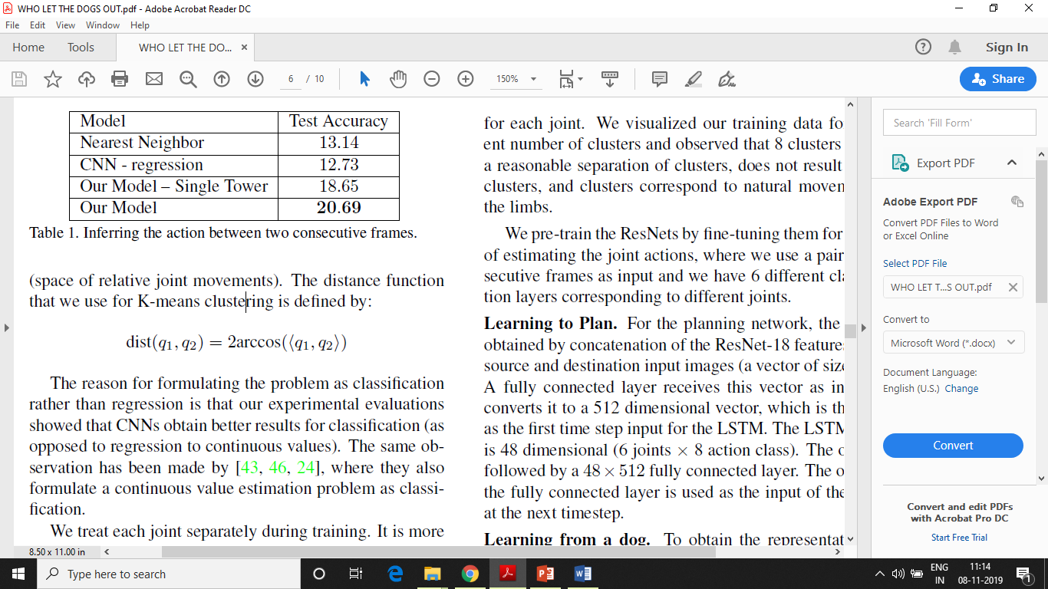
Learning To Plan
Here, the input is obtained by concatenation of ResNet-18 features for the source & destination input images (a vector of size 2048).
Fully connected layer receives this vector as input and convert it to 512 dimensional vector, which is used as first time step input for the LSTM.
The LSTM output is 48 dimensional ( Joints X Action Classes), which is followed by 48 X 512 Fully connected layer. Then Output of FC layer is used as input to LSTM at next step.
Learning From A Dog
To obtain representation ResNet-18 model is trained to estimate dog movements from time t-1 to t by looking at images at time t-1 and t.
A Siamese network is used with two ResNet-18 towers whose weights are shared.
Features of both frames are then concatenated into a 1024 dimensional vector and used as FC layer to predict final labels.
Table 1 show how well this network can predict current movements of the dog.

Slide 21
Evaluation Metrics
Class Accuracy :
This is standard metric for classification tasks.
The average per class accuracy is reported rather than overall accuracy because:
The dataset is not uniformly distributed among the clusters and authors do not wanted to favour large clusters smaller ones.
Unlike the overall unbalanced accuracy, the mean class accuracy of a model that always predicts the mode class is higher than chance.
Perplexity :
It measures the likelihood of the ground-truth label.
Perplexity is reported for all the baselines and models that are probabilistic and predict a sequence.
According to authors if probability is assigned as p to a sequence of length n, the perplexity measure is calculated as p^{1/n}.

Slide 22
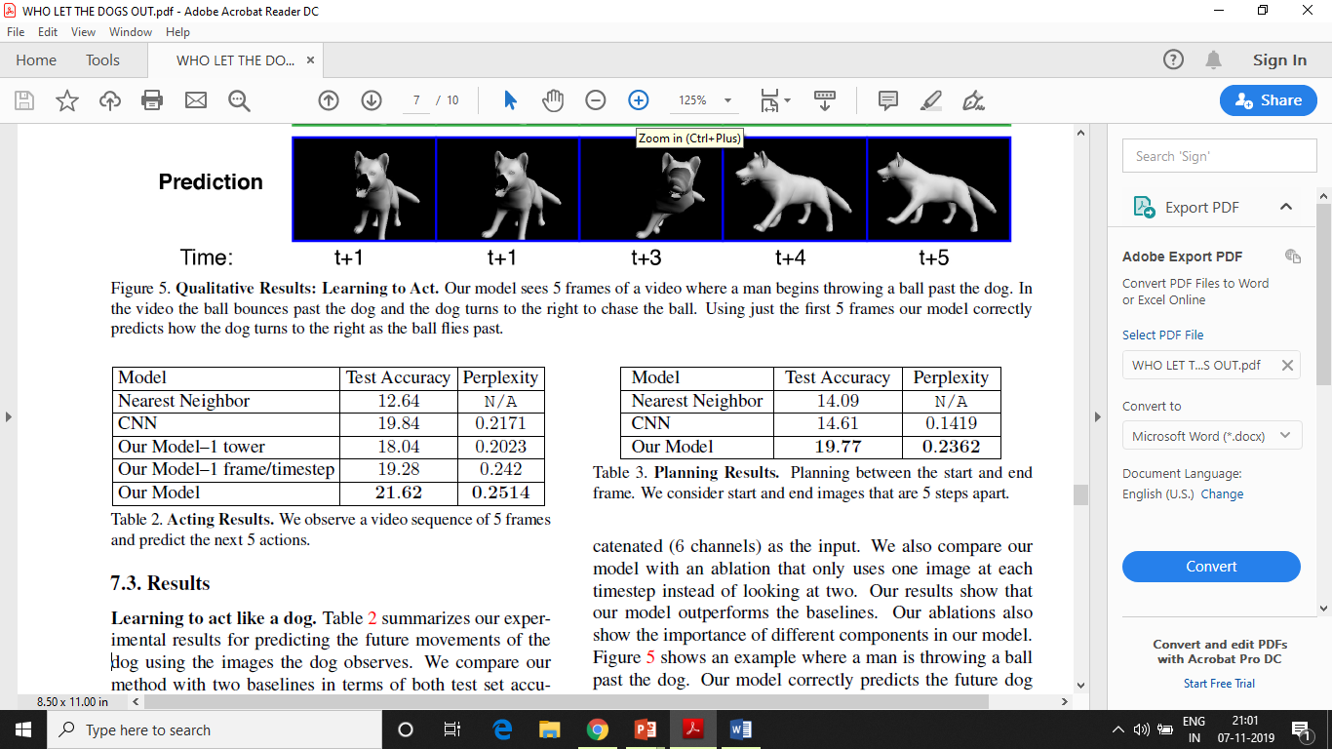
RESULTS
Learning to act like a Dog
The table summarizes the experiment results for predicting future movements of dog using images the dog observes.
The nearest neighbour baseline uses features obtained from ResNet18 network trained on ImageNet.
The CNN baseline concatenates all the images into an input tensor for a ResNet18 model that classifies the future actions.
Further two ablations of model are there:
The 1 tower ablation uses model in Fig. 2 but only one Resnet18 tower with both frames concatenated as input.
The second ablation uses one image at a time step instead of taking two.
These ablations show importance of components in the model & results show their model outperforms the baseline.

Slide 23
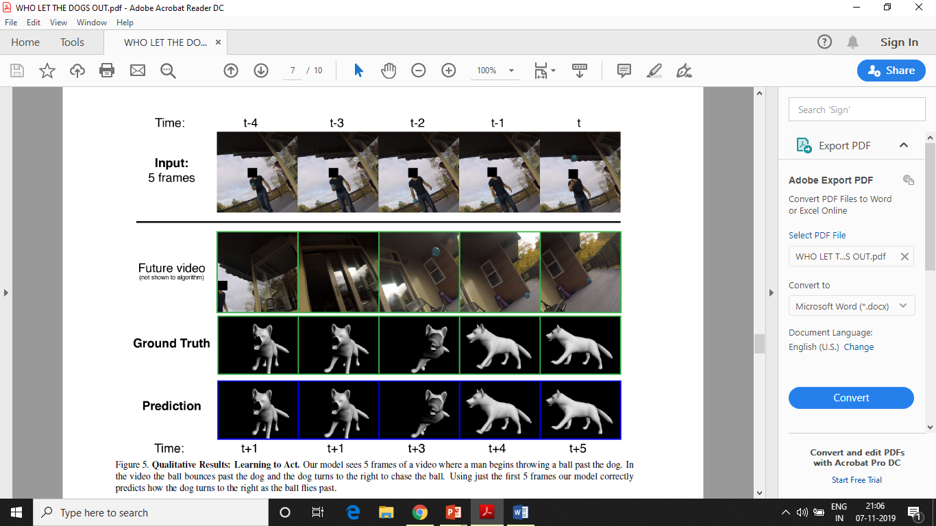

Slide 24
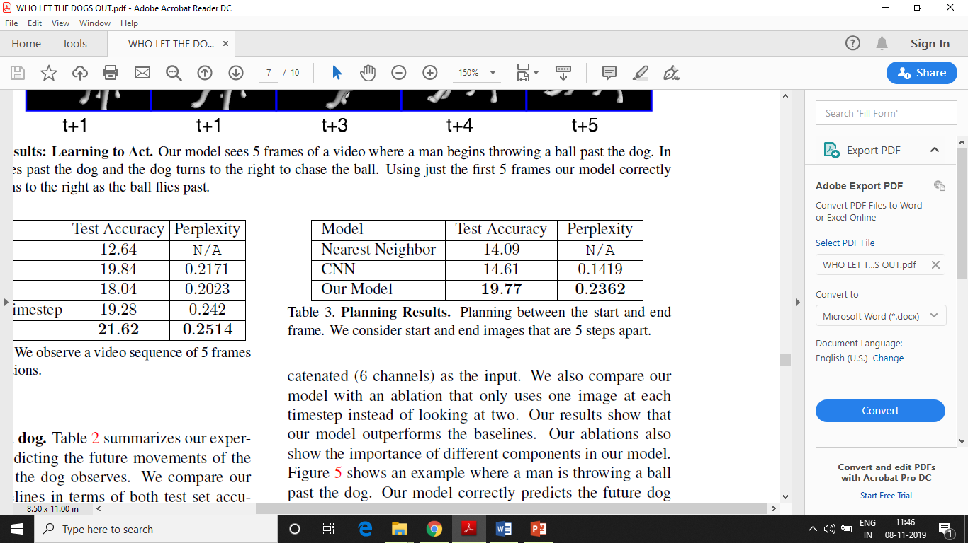
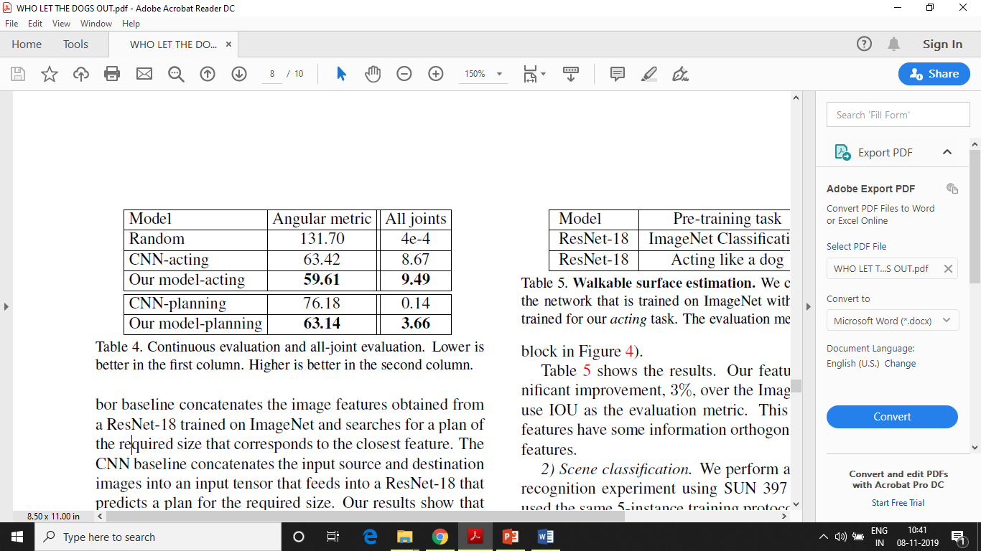
Learning to plan like a Dog
The nearest neighbour baseline concatenate the image feature obtained from a ResNet-18 trained on ImageNet and searches for a plan of required size that correspond to the closest feature.
The CNN baseline concatenates the input source and destination images into an input tensor that feeds into a ResNet-18 that predicts plan for required size.
The authors model outperforms these baselines in the challenging task of planning like a dog.
For better understanding behaviour of model for acting and planning the performance is shown in terms of a continuous angular metric.
The angular metric compares the mean of predicted cluster with the actual continuous joint movements in groundtruth (arccos(2(q_{pred}.q_{gt})²-1)
Where, q_{pred} and q_{gt} are the predicted and groundtruth quaternion angles, respectively.
All joint metric calculates the percentage of correct predictions.

Slide 25
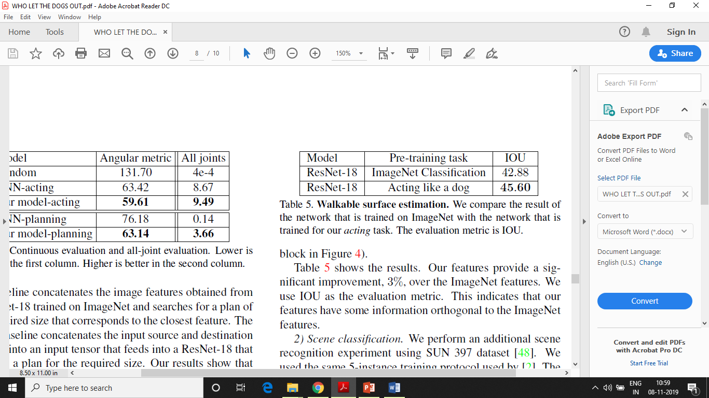
Learning from a Dog
Walkable Surface Estimation:
The goal for this task was to label pixels that corresponds to walkable regions in an image.
Dataset used in “A task- oriented approach for cosy-sensitive recognition” was used. Also authors dataset was used which includes sequence of dag walking indoor and outdoor scenes.
Authors trained ResNet-18 on ImageNet and then fine-tuned it on the walkable surface dataset as their baseline.
For finetuning the models, authors updated the weights for the last convolution layer (Fig. 4).
Authors features provided a significant improvement of 3% (2.72%) over the ImageNet features. IOU was used as evaluation metric.

Slide 26
Scene Classification:
An additional scene recognition experiment was performed using SUN 397 dataset.
The same protocols were used those were used in “Learning to see by moving”.
The representations learned by authors obtained accuracy of 4.48.
This was interesting as their dataset does not include many type of scenes such as gas station, store etc.

Slide 27
Conclusion
The experiments show that authors model can make predictions about the future movements of dog and can plan movements similar to the dog.
Despite of lack of semantic labels this model can be used on a wide variety of agents and scenarios to learn useful information.
FUTURE SCOPE:
Authors are interested in expanding their model to encompass more input modalities in a combined end to end model.
Also only a single dog was used for modelling, authors are interested in collecting data from multiple dogs and evaluate generalization across dogs.

Slide 28
The most technologically efficient machine that man has ever invented is the BOOK
-Northrop Frye
Go through the boks there are hell lot of concepts in this study!!
THANK YOU!!

